Slide 1
FBLA District 8​​ Advisers Meeting​ 8/3/20​ 11:00am Welcome Back!

Slide 2
D8 - Schools
Armwood, Bowers-Whitley, Freedom, King, Middleton, Plant City, Strawberry Crest, TBT, Wharton, Liberty, Sligh, Williams, Young, Sulphur Springs, Woodson
Rodgers, Benito, Bartels, Greco

Slide 3
State Awards
The FBLA State Awards Ceremony video is still available. http://www.thinkcybis.com/flfbla-live/

Slide 4
Congratulations! - State Winners State - 443 Chapters – 15 D8 – 104
King HS – 26 Awards – Debra Mosley
Freedom HS – 4 Awards – Brian Nanns
Liberty MS – 9 Awards – Daisy Questell
Middleton HS – 37 Awards – Olutayo Akinrefon
Strawberry Crest HS – 11 Awards – Jasmine Lane
Sulphur Springs K-8 – 1 Award – Danielle Atherton-Bonner
Wharton HS – 1 Award – Erika Chisholm
Williams IB – 15 Awards – TeShanna Rayner

Slide 5
More State Awards
Shruti Shivan, State Officer - Region IV VP - King HS
Aditi Mishra - Beau Schenecker Leadership Scholarship - $2,500
Aditi Mishra – Who's Who in FBLA - King HS
Lead Program Silver Level Award
22 members – Liberty MS

Slide 6
National Awards Florida - 88 D8 – 31
King HS – 7
Middleton HS – 14
Strawberry Crest HS – 5
Williams MS – 4
Liberty MS – 1
Lead Program Gold Level Award
22 members – Liberty MS

Slide 7
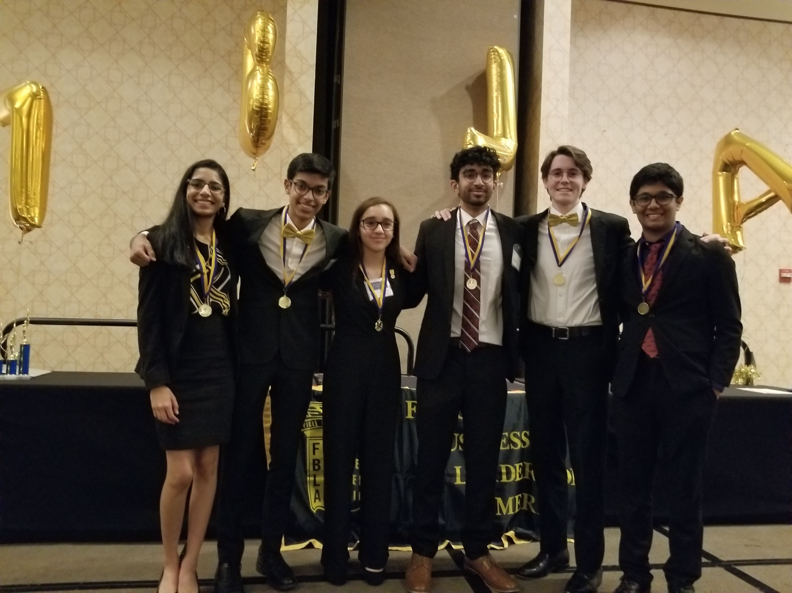
District 8 Officers Update
Ojas President | ?
Asa Vice-President | elearning
Ysabella | Virtual/No FBLA
Varun Secretary | elearning
Ananya Reporter | school
Saketh Historian | elearning

Slide 8
District Theme and Project
Theme – Destined for Greatness
Project – District T-shirts to benefit the district and the Baldomero Lopez Veterans Nursing Home - Tentative

Slide 9
State Theme and Project
State Theme - Reimagine Tomorrow
State Project - March of Dimes
Activity Goal – Keep Florida Beautiful; fall date and February date

Slide 10
National Theme
Aspire
Logo package is out on the National Website

Slide 11
Membership Dues
National Dues = $6
State Dues = $4
District Dues = $3
Chapter Dues = 7
Students paying online (talk to your bookkeepers)
Chapters sending checks to district

Slide 12
District 8 – Virtual Recruitment
Website -
Twitter – Hillsborough FBLA District 8

Slide 13
Monthly Webinars? District meetings?
Record 10-15 minutes video
Post them on the website, twitter

Slide 14
Fall Leadership Conference
National - Might be one in Daytona but it is still TBD - November
State - Discussions are being held for a Virtual Fall Leadership Conference in October.

Slide 15
State Leadership Conference
Tentative
March 25 – 28
Hilton Orlando

Slide 16
National Leadership Conference
Tentative
June 29 – July 2 – Anaheim, CA

Slide 17
Changes to Events
New Event – Supply Chain Management – Objective test, individual event
New Event – Introduction to Event Planning – 9th/10th grade event, individual/team event, preliminary round objective test, final round role- play
Modification – changed the name of Hospitality Management to Hospitality and Event Management
Modification – changed Social Media Campaign to Introduction to Social Media Strategy – 9th/10th grade event, individual/team event, topic posted on website, preliminary round presentation for all competitors at NLC
New Event – Social Media Strategies – individual/team event, topic posted on website, preliminary round presentation for all competitors at NLC

Slide 18
Changes to Events, cont.
Retired Event – Emerging Business Issues
Modification - Sales Presentation will now be an individual/team event
Modification – Digital Video Production and Public Service Announcement – these videos must be original content; competitors may not use previously published video clips in the videos they submit for competition
Modification – changed name of Global Business to International Business
Modification – changed name of Networking Concepts to Networking Infrastructure

